Slide 1
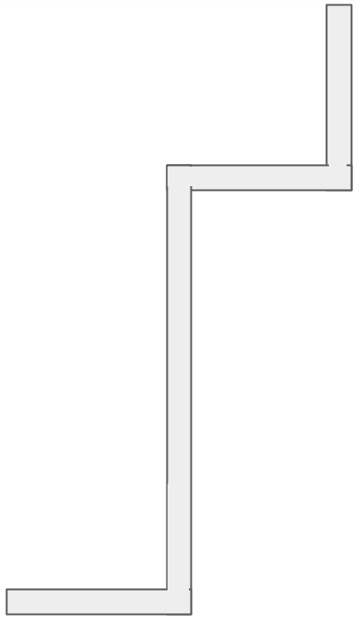

Portable Charger
Webcam
Logitech HD webcam C525
Wireless Keyboard & Mouse
Ball Dropper
USB
USB
Type C USB Cable
USB Connection
USB Hub
USB Connection
Raspberry Pi 4
Kill
Switch
XSENS MTI-300-2A8G4
USB Connection
USB Connection
Ball
Dropper
Kill
Switch
USB Connection
Interface
Board
Schematic Diagram
Ribbon Cable
RPi.Screen
Raspberry Pi
Display
Arduino
MEGA
Ethernet Cable
Mounted on top
I2C Level Convertor
Sonar BLUART
11.1V Lipo
Depth Sensor
BAR30
RPI.SBTOOTH
ARD.SBTOOTH
0V
S1
0V
S1
SONAR
Sabertooth
V2.00
Sabertooth
V2.00
ZOLTA
LiPo Batteries
11.1V
3S
Thruster
M1A
M1B
B+
B-
M2A
M2B
Thruster
Thruster
M1A
M1B
B+
B-
M2A
M2B
Thruster
KeyBoard
Mouse
+
-
+
-
+
-
+
-
+
-

Slide 2
Schematic Diagram
Old Schematic from 2020 Sem 2
KeyBoard
Portable Charger
Mouse
SONAR
5V
5V
GND
GND
Micro USB Cable
Wireless Keyboard & Mouse
RX
TX
BLUSART (USB to TTL)
TX
RX
Serial Port = /dev/ttyUSB3
Raspberry Pi 4
Webcam
Logitech HD webcam C525
Serial Port = /dev/ttyUSB4
Serial Port = /dev/ttyUSB2
Serial Port = /dev/ttyUSB1
Serial Port = /dev/ttyUSB0
GPIO 24
GND
GPIO
14
GPIO 23
XSENS MTI-300-2A8G4
52
Arduino
MEGA
5V
5V
GND
GND
I2C Level Convertor
KillSwitch
SDA
330R
SDA
(A4)
SCL
10kR
SCL
(A5)
GND
11
GND
5V
0V
S1
0V
S1
Sabertooth
V2.00
ZOLTA
LiPo Batteries
11.1V
3S
Sabertooth
V2.00
Depth Sensor
BAR30
12V
TIP120
820R
Thruster
Thruster
Solenoid
Thruster
M1A
M1B
B+
B-
M2A
M2B
M1A
M1B
B+
B-
M2A
M2B
Thruster
BallDropperPCB
1N4007
+
-
+
-
+
-
+
-
-
+
Linear Actuator

